Slide 1

Qualification and Application of Ultrasonic Technology for Power Plant Component Fouling Control
Presenter: Chuck Marks
Co-authors: Marc Kreider, Jean Collin, Josh Luszcz

Slide 2
Topics
Cement solidification system (CSS) overview
Ultrasonic energy cleaning (UEC) systems developed for CSS
Structural analyses and laboratory validation
Material integrity testing
Effectiveness testing
Field results

Slide 3
CSS Background
Wiped-film evaporator (dryer) is used in a nuclear power station to treat liquid low-level radwaste
  Calcium borate particulates generated by chemical treatment
  Particulates isolated through evaporation and then packaged for disposal
Buildup of deposits on surfaces throughout the dryer led to off-normal thermal-hydraulic conditions and reduced dryer efficiency
Manual / water-jet cleaning were initially implemented: labor-intensive with risk of personnel contamination

Slide 4
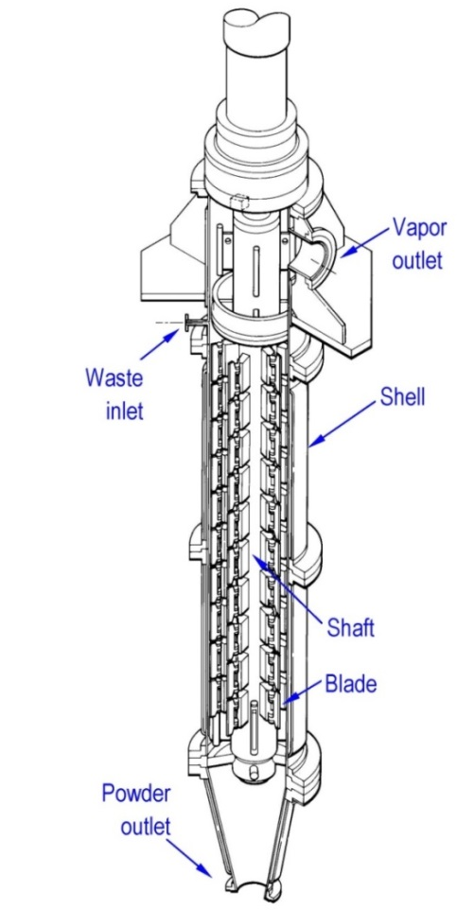
Cement Solidification System Dryer
Four upper UEC transducers mounted on top flange
Powder outlet cone removed during UEC and replaced with lower UEC transducer assembly

Slide 5
Development of CSS UEC Systems
Two ultrasonic systems constructed:
  The first (“upper system”) consists of four externally mounted transducers focused on cleaning the liquid distribution ring (fouling leads to flow maldistribution and performance problems)
  The second (“lower system”) targets cleaning the lower dryer internals, including central shaft and wiper blades
Upper system may be operated online and offline (deposit prevention and cleaning)
Lower system requires flooding of the dryer and may only be operated offline

Slide 6
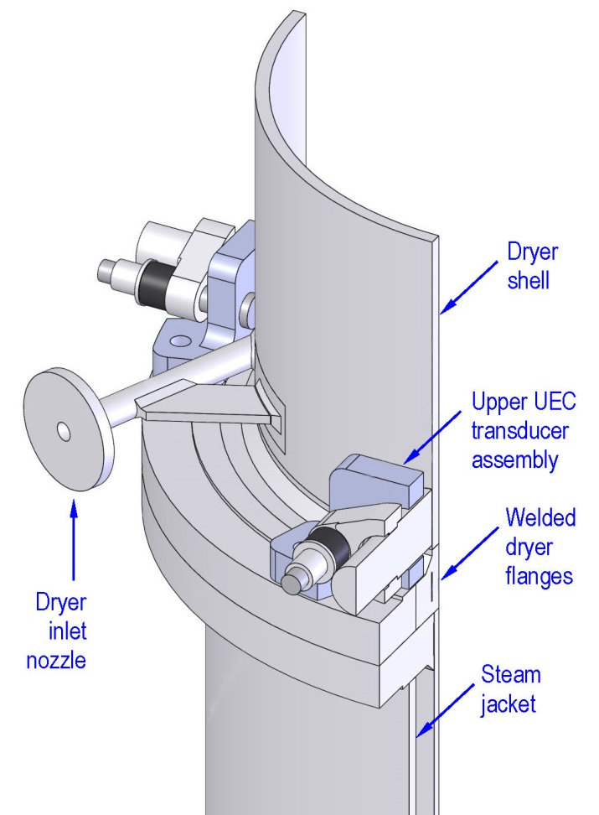
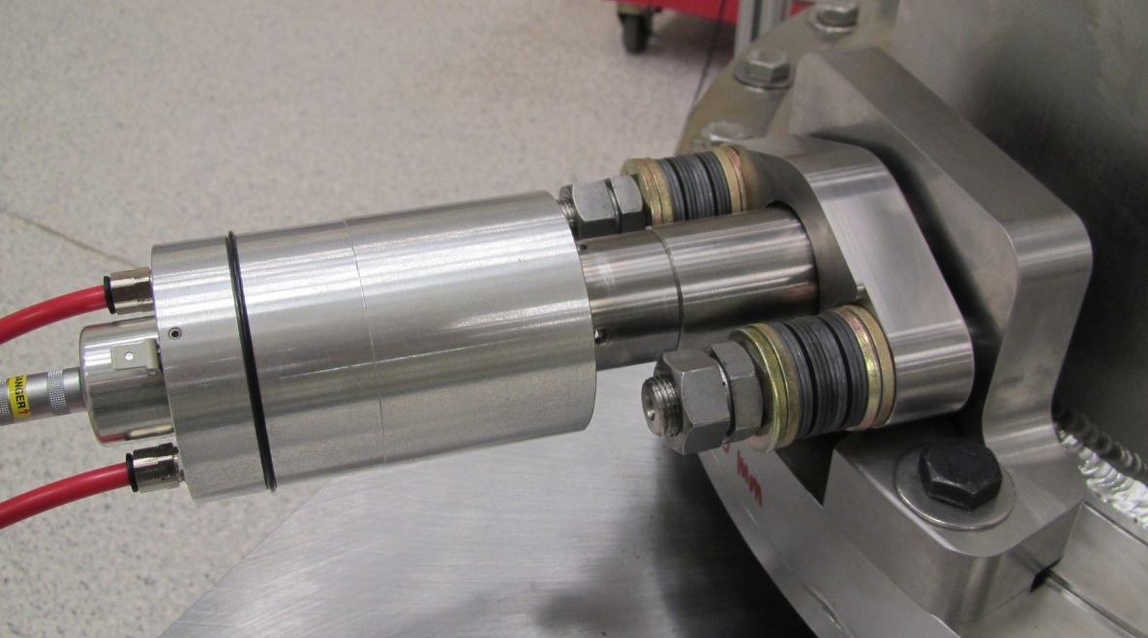
Upper UEC Transducer Assemblies
CSS dryer cutaway showing 2 of 4
upper transducers
Upper transducer installed on dryer mockup

Slide 7
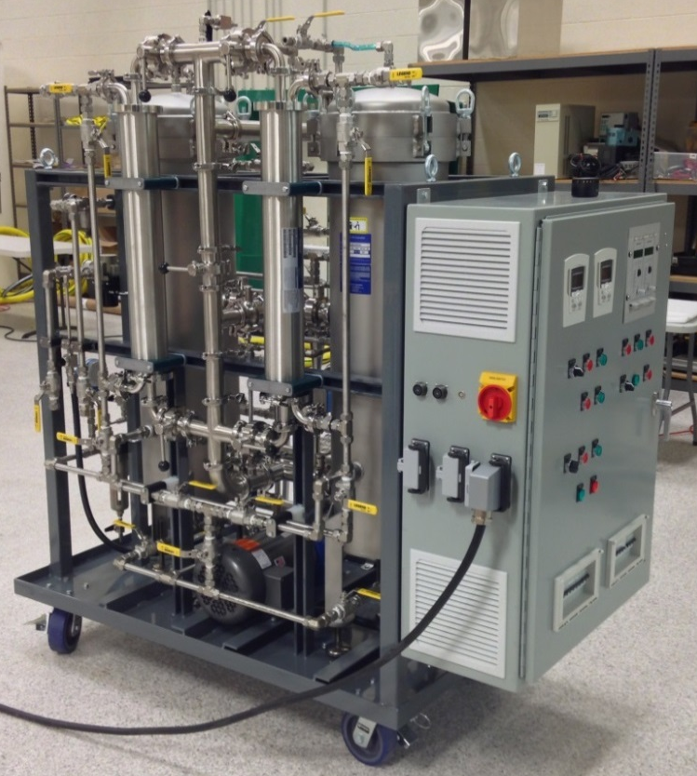
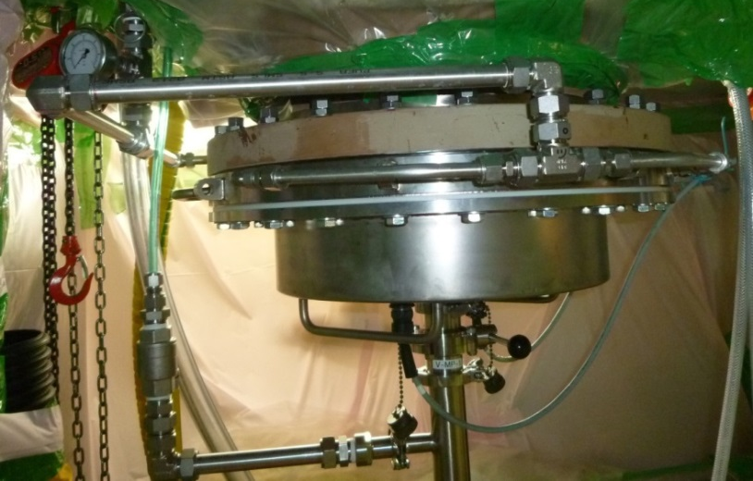
Lower UEC Equipment
Field installation of lower UEC transducer assembly
Lower UEC controls:
level, temperature, dissolved gas, particle filtration, transducer on/off

Slide 8
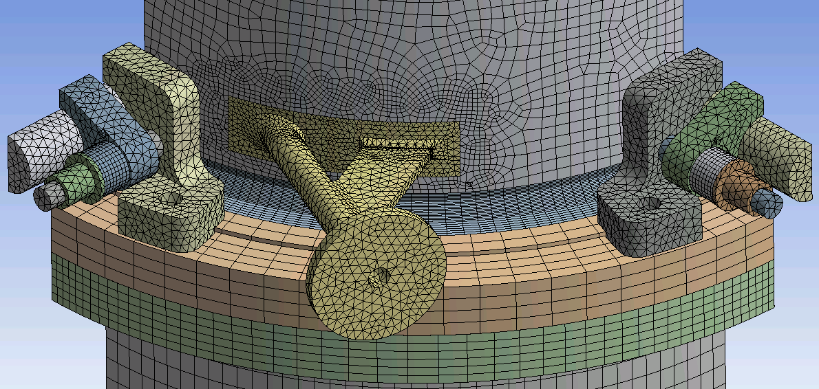
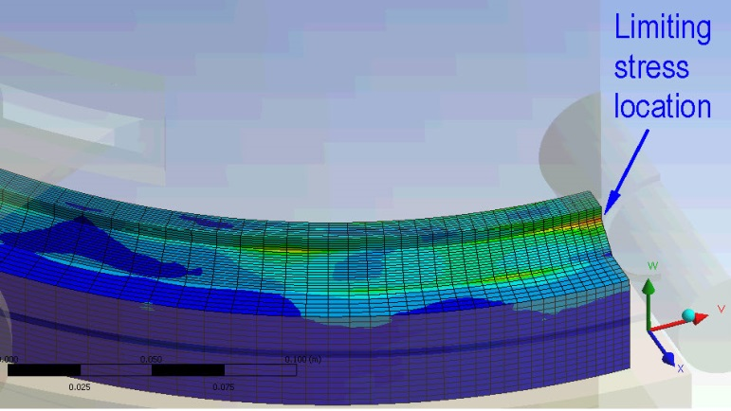
Upper UEC Structural Analysis
Determination of
limiting stress intensity
Upper UEC finite element mesh (top)
Harmonic stress intensity during UEC (bottom)

Slide 9
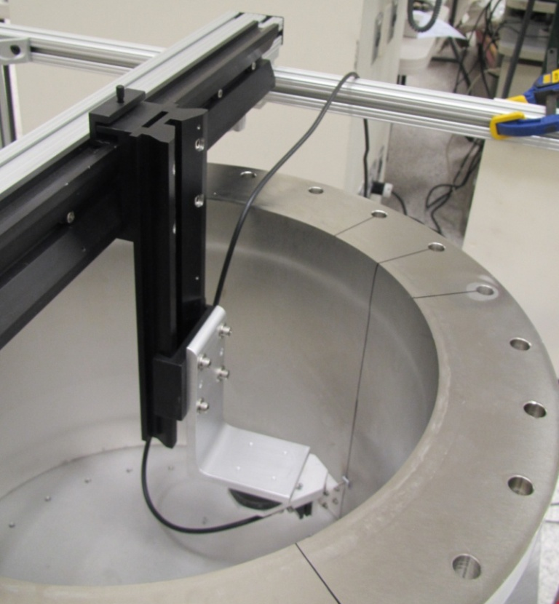
Upper UEC FE Model Validation
Laboratory measurement of dryer mockup shell displacements
Laboratory shell displacement measurement results

Slide 10
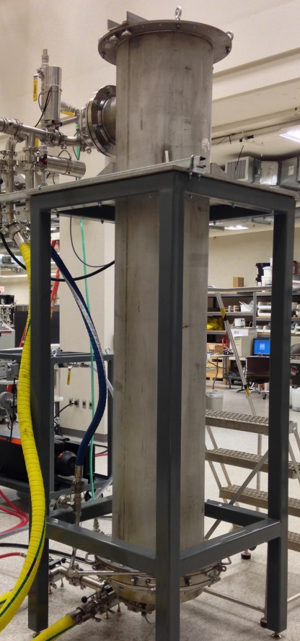
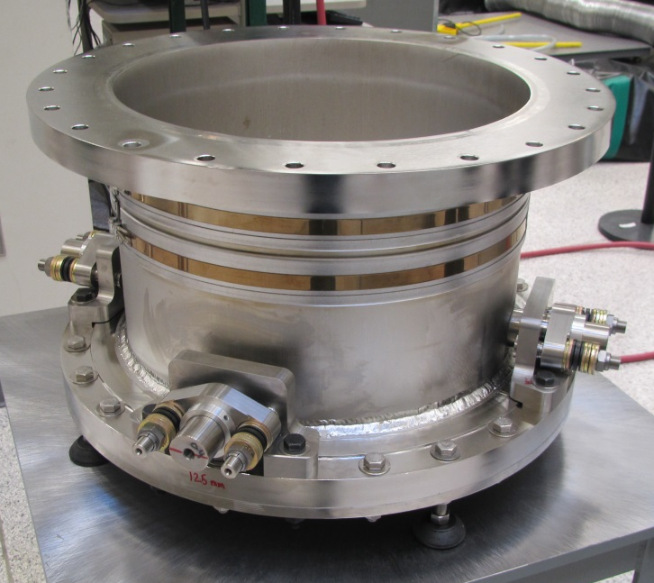
Material Integrity Testing Facilities
Upper UEC mockup
Lower UEC mockup

Slide 11
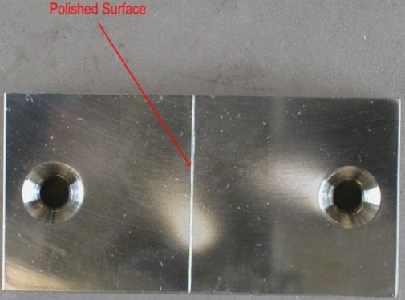
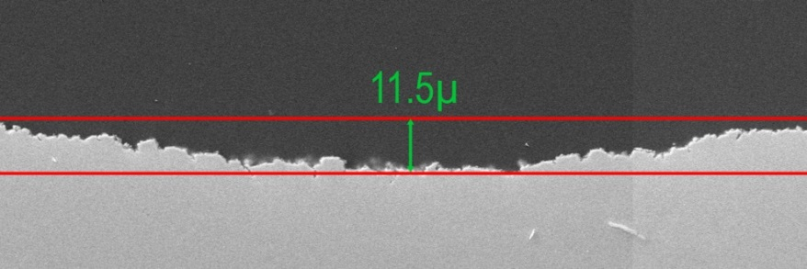
Material Integrity Testing Results
UEC cavitation erosion
on test coupon
Scaled microphotograph of cavitation erosion (cross section)
Testing showed acceptably low levels of erosion compatible with planned periodic surface inspections

Slide 12
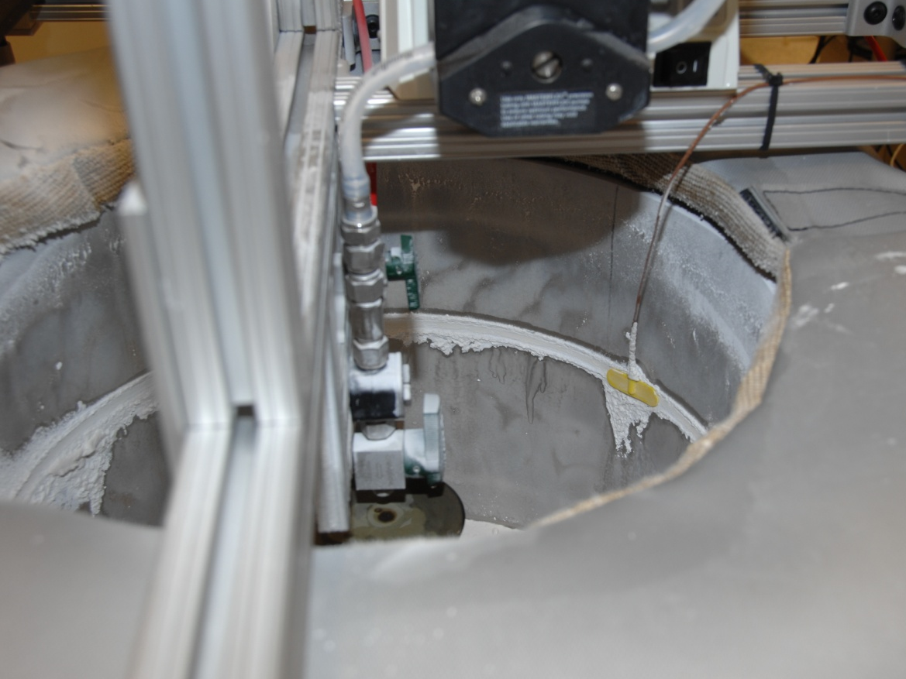
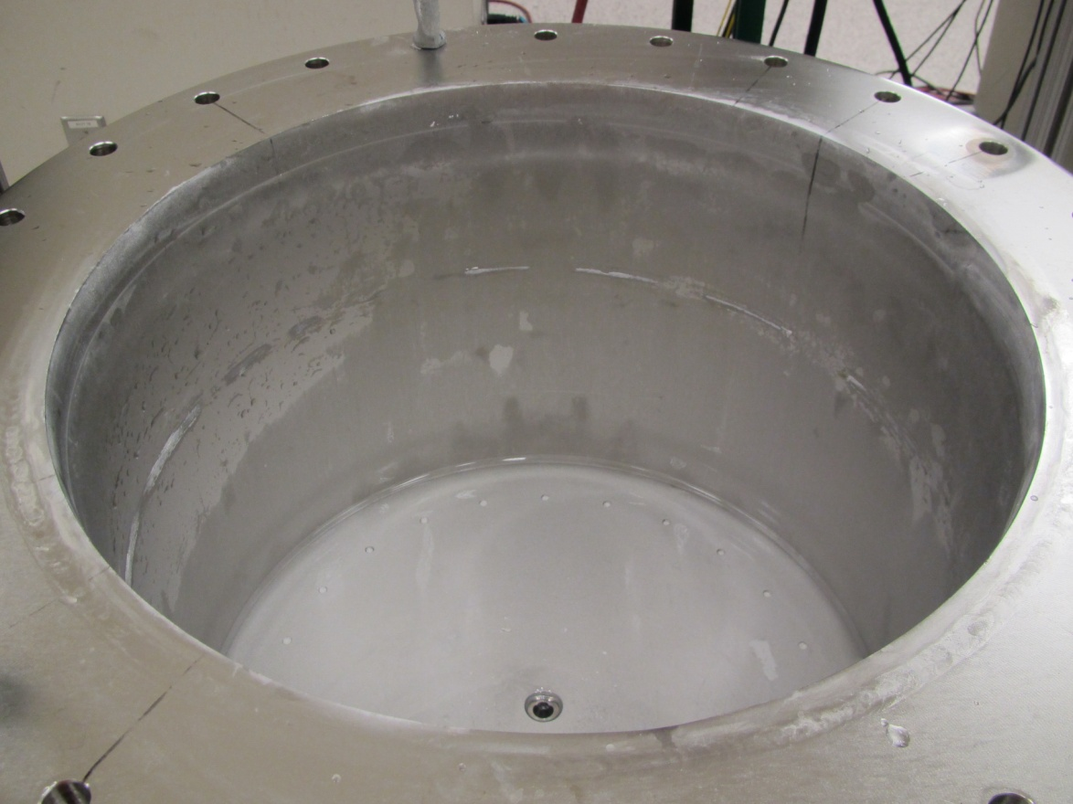
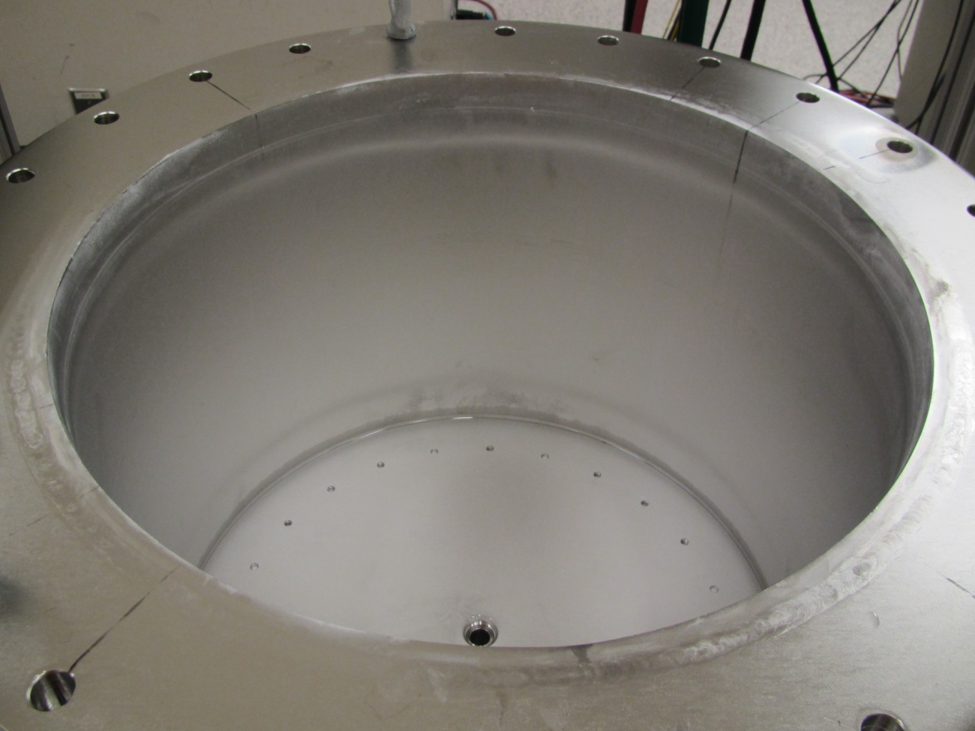
Upper UEC Effectiveness Testing
Initial deposits (t = 0)
t = 3 h
t = 5 h
Testing demonstrated complete removal of tenacious calcium borate deposits after several hours of UEC

Slide 13
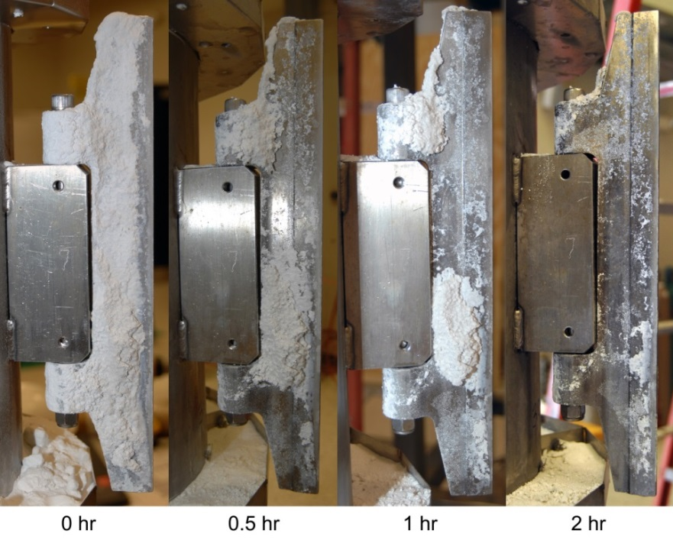
Lower UEC Effectiveness Testing
Actual CSS dryer blades fouled in the vendor’s test facility were 97–99% clean after <5 hours of UEC

Slide 14
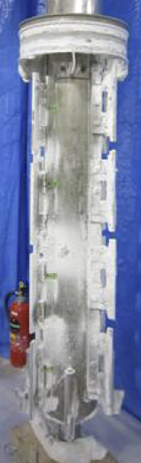
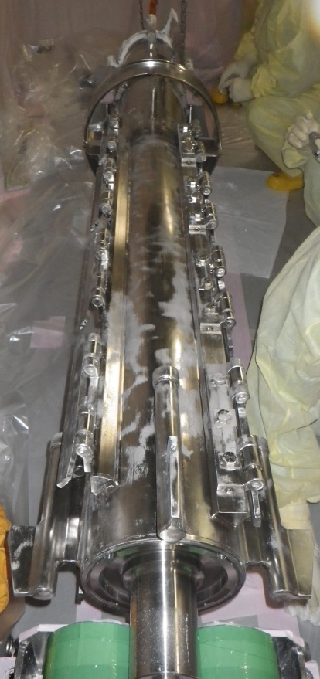
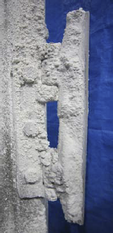
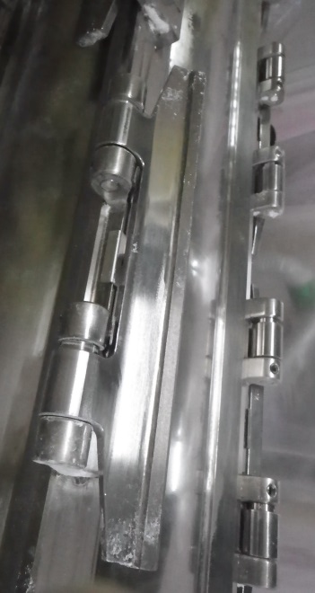
Field Results (1/2)
``
``
Without cleaning
After UEC
Internals removed only for inspection of cleaning efficiency after first-of-a-kind application. Routine removal of internals not needed.
Typical CSS dryer shaft without cleaning
CSS dryer shaft after UEC

Slide 15
Field Results (2/2)
Trends in differential pressure across particle filter elements suggested complete cleaning in <6 hours

Slide 16
Summary
A wiped-film evaporator (dryer) used to process low-level radwaste in a nuclear station experienced rapid, extensive fouling with calcium borate deposits
Two custom ultrasonic energy cleaning (UEC) systems were developed to remove these deposits
Extensive testing and structural evaluations demonstrated that the UEC systems are:
  Effective at removing tenacious calcium borate deposits
  Safe for the dryer materials exposed to ultrasonic vibrations
Key benefits of the UEC systems for this application:
  Dryer performance was restored
  Manual cleaning protocols were eliminated
  (time consuming, risk of personnel contamination)

Slide 17
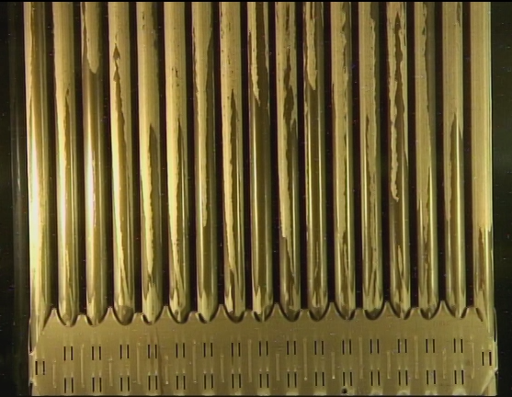
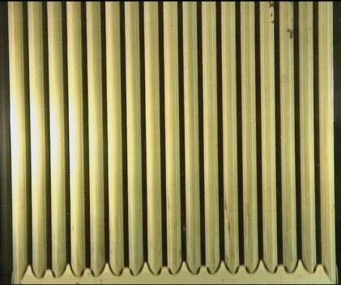
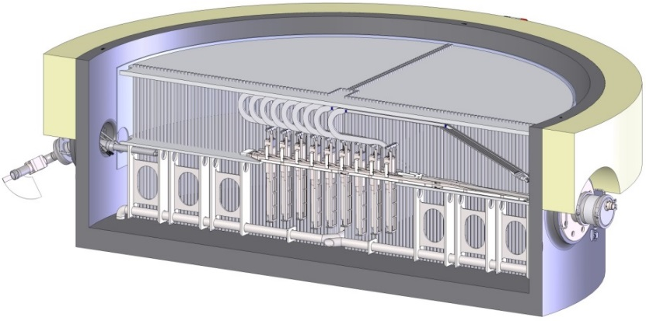
Other DEI Cleaning Applications
Fuel/reactor services
  High efficiency ultrasonic fuel cleaning
  Vacuum canister fuel sipping
  (fuel leak detection)
  Ultrasonic jet pump cleaning
Mechanical cleaning equipment
  Sludge flush system (hydraulic)
  Ultrasonic devices (SGs, piping, BWR jet pumps, filters/resin vessels, hot spot removal)
Chemical cleaning/treatment processes
  SG cleaning (ASCA, CODE, etc.)
  Dose reduction/passivation (LT-ZP)
Before HE-UFC
After HE-UFC

